Slide 1
Announcements
Midterm 1 is on Tuesday
Topics covered: Python Knowledge, Uninformed Search, Informed Search, Constraint Satisfaction Problems, Adversarial Search.
Read AIMA Chapters 2.1 and 2.2, 3.1-3.6, 5.2-5.5, 6.1-6.5, and 16.1-16.3.
The midterm is a closed book exam. No notes. No devices.
There is a practice exam on the course web site

Slide 2
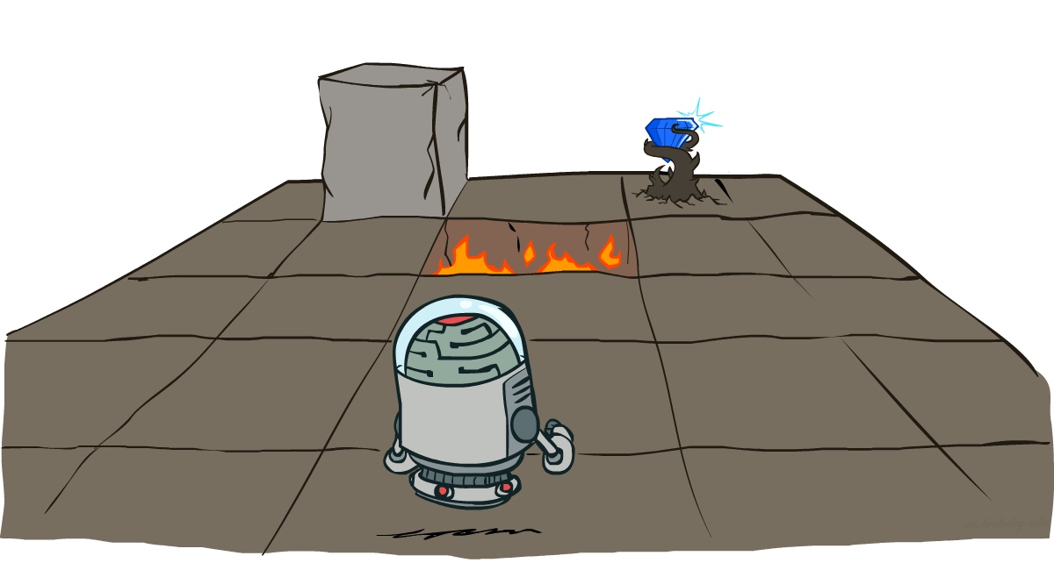
Markov Decision Processes
Slides courtesy of Dan Klein and Pieter Abbeel
University of California, Berkeley
[These slides were created by Dan Klein and Pieter Abbeel for CS188 Intro to AI at UC Berkeley. All CS188 materials are available at http://ai.berkeley.edu.]
Notes:
Please retain proper attribution, including the reference to ai.berkeley.edu. Thanks!

Slide 3
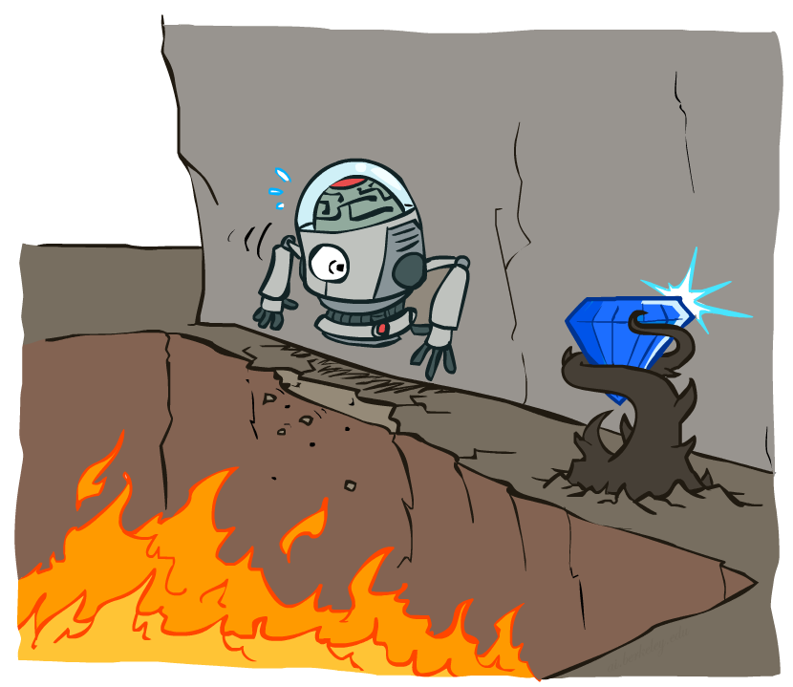
Non-Deterministic Search

Slide 4





Example: Grid World
A maze-like problem
The agent lives in a grid
Walls block the agent’s path
Noisy movement: actions do not always go as planned
80% of the time, the action North takes the agent North (if there is no wall there)
10% of the time, North takes the agent West; 10% East
If there is a wall in the direction the agent would have been taken, the agent stays put
The agent receives rewards each time step
Small “living” reward each step (can be negative)
Big rewards come at the end (good or bad)
Goal: maximize sum of rewards
Notes:
[cut demo of moving around in grid world program]

Slide 5
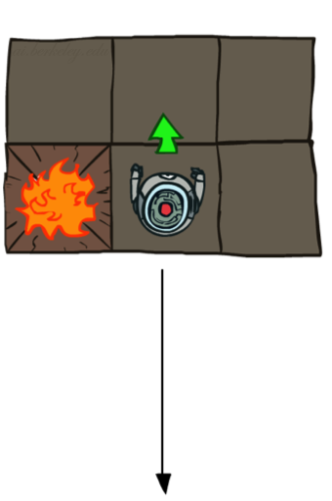
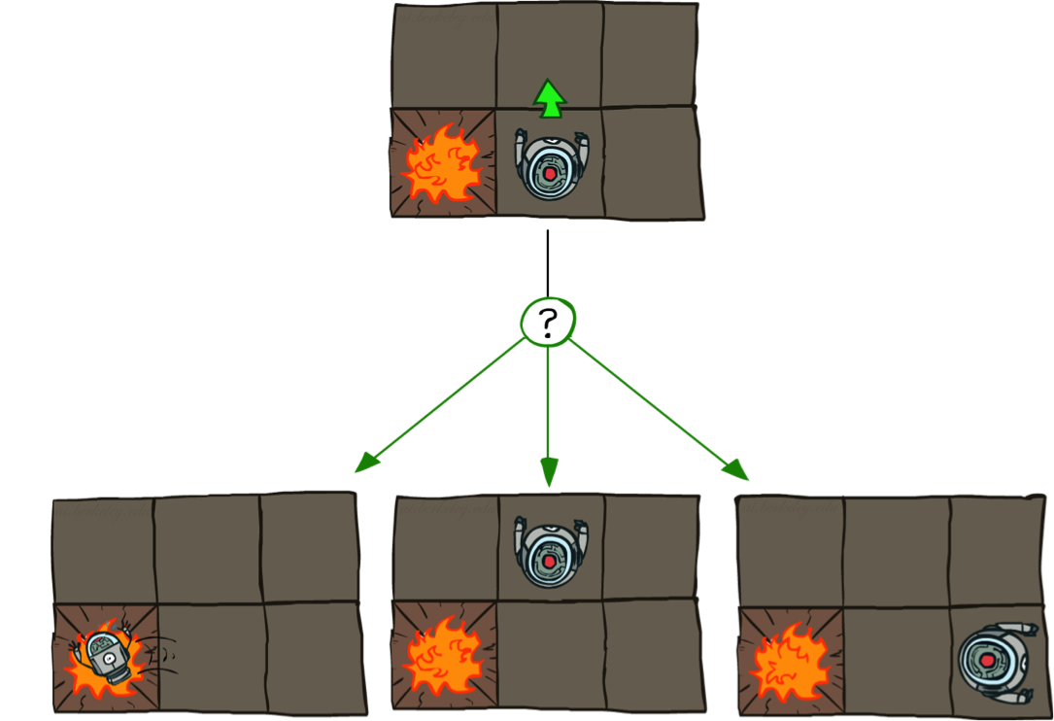

Grid World Actions
Deterministic Grid World
Stochastic Grid World

Slide 6
Markov Decision Processes
An MDP is defined by:
A set of states s ∈ S
A set of actions a ∈ A
A transition function T(s, a, s’)
Probability that a from s leads to s’, i.e., P(s’| s, a)
Also called the model or the dynamics
A reward function R(s, a, s’)
Sometimes just R(s) or R(s’)
A start state
Maybe a terminal state
MDPs are non-deterministic search problems
One way to solve them is with expectimax search
We’ll have a new tool soon
Notes:
In search problems: did not talk about actions, but about successor functions --- now the information inside the successor function is unpacked into actions, transitions and reward
Write out S, A, example entry in T, entry in R
Reward function different from the book : R(s,a,s’)
In book simpler for equations, but not useful for the projects.
Need to modify expectimax a tiny little bit to account for rewards along the way, but that’s something you should be able to do, and so you can already solve MDP’s (not in most efficient way)

Slide 7

Video of Demo Gridworld Manual Intro

Slide 8

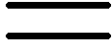
What is Markov about MDPs?
“Markov” generally means that given the present state, the future and the past are independent
For Markov decision processes, “Markov” means action outcomes depend only on the current state
This is just like search, where the successor function could only depend on the current state (not the history)
Andrey Markov (1856-1922)
Notes:
Like search: successor function only depended on current state
Can make this happen by stuffing more into the state;
Very similar to search problems: when solving a maze with food pellets, we stored which food pellets were eaten

Slide 9

Policies
In deterministic single-agent search problems, we wanted an optimal plan, or sequence of actions, from start to a goal
For MDPs, we want an optimal policy π*: S → A
A policy π gives an action for each state
An optimal policy is one that maximizes expected utility if followed
An explicit policy defines a reflex agent
Expectimax didn’t compute entire policies
It computed the action for a single state only
Optimal policy when R(s, a, s’) = -0.03 for all non-terminals s
Notes:
Dan has a DEMO for this.

Slide 10
Optimal Policies
R(s) = -0.01
R(s) = -0.03
R(s) = -0.4
R(s) = -2.0
Notes:
R(s) = the “living reward”

Slide 11
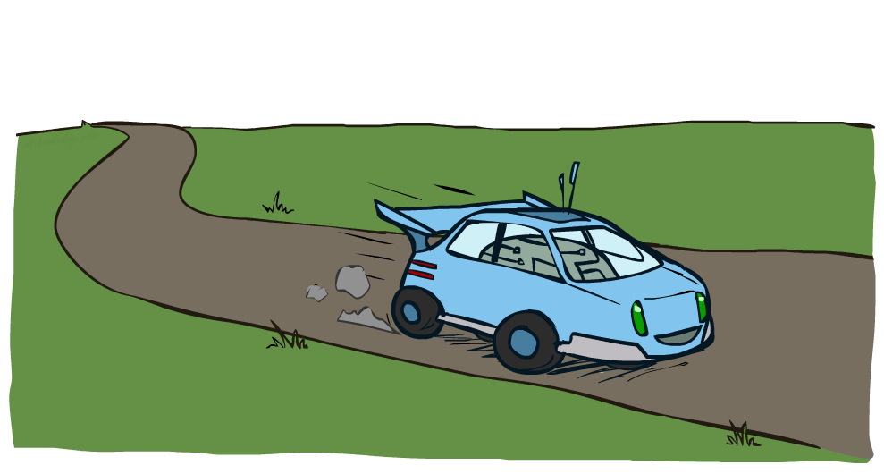
Example: Racing

Slide 12
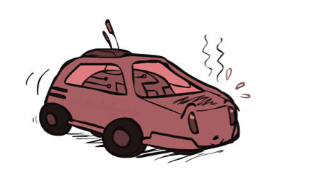
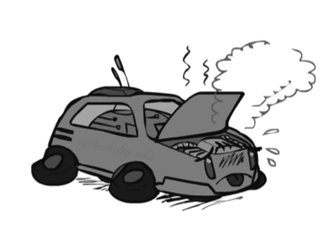
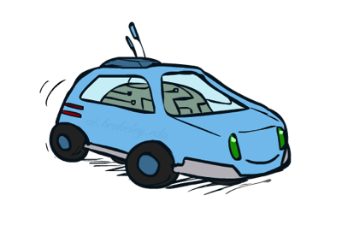
Example: Racing
A robot car wants to travel far, quickly
Three states: Cool, Warm, Overheated
Two actions: Slow, Fast
Going faster gets double reward
0.5
+1
1.0
Fast
Slow
-10
+1
0.5
Warm
Slow
Fast
0.5
+2
Cool
0.5
Overheated
+1
1.0
+2

Slide 13




Racing Search Tree

Slide 14


MDP Search Trees
Each MDP state projects an expectimax-like search tree
s
s is a state
a
(s, a) is a q-state
s, a
(s,a,s’) called a transition
T(s,a,s’) = P(s’|s,a)
R(s,a,s’)
s,a,s’
s’
Notes:
In MDP chance node represents uncertainty about what might happen based on (s,a) [as opposed to being a random adversary]
Q-state (s,a) is when you were in a state and have committed to take an action an action
Differences with expectimax tree: (1) Transition function encodes the probabilities. (2) Rewards are given on each state of the tree, rather than all the way on the bottom at the terminal nodes.

Slide 15
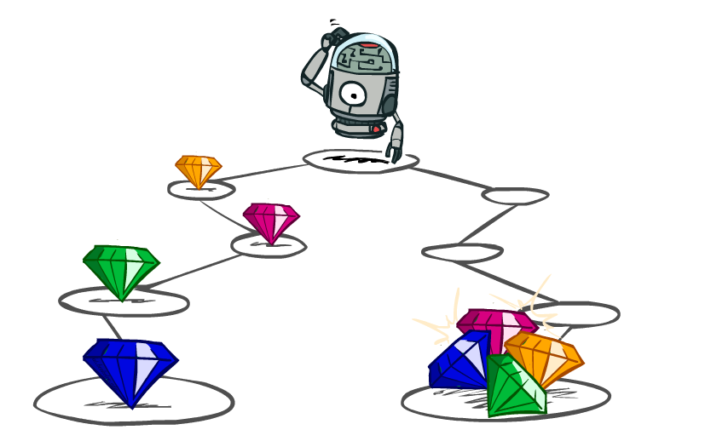
Utilities of Sequences
Notes:
In MDPs, rewards come to you step by step.
We need to decide what our reward function should be.
For example here, we might have a different way of rewarding this agent. One by giving the rewards incrementally, and one by giving them all at the end.

Slide 16
Utilities of Sequences
What preferences should an agent have over reward sequences?
More or less?
Now or later?
[1, 2, 2]
or
[2, 3, 4]
[0, 0, 1]
or
[1, 0, 0]

Slide 17




Discounting
It’s reasonable to maximize the sum of rewards
It’s also reasonable to prefer rewards now to rewards later
One solution: values of rewards decay exponentially
Worth Now
Worth Next Step
Worth In Two Steps

Slide 18

Discounting
How to discount?
Each time we descend a level, we multiply in the discount once
Why discount?
Sooner rewards probably do have higher utility than later rewards
Also helps our algorithms converge
Example: discount of 0.5
U([1,2,3]) = 1*1 + 0.5*2 + 0.25*3
U([1,2,3]) < U([3,2,1])
Notes:
Rewards in the future (deeper in the tree) matter less
Interesting: running expectimax, if having to truncate the search, then not losing much; e.g., less then \gamma^d / (1-\gamma)

Slide 19
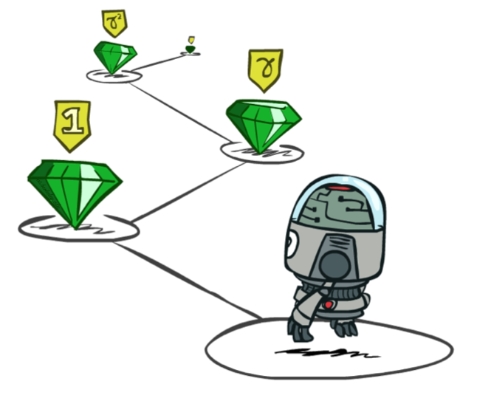
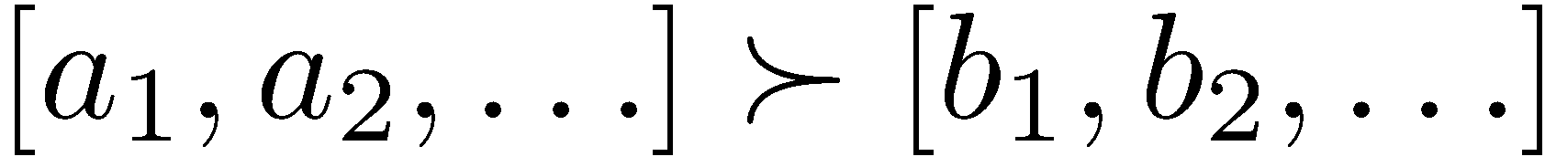
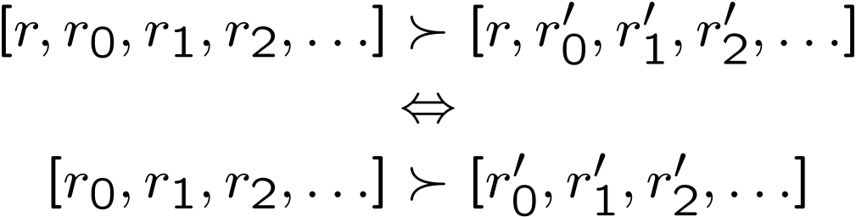
Stationary Preferences
Theorem: if we assume stationary preferences:
Then: there are only two ways to define utilities
Additive utility:
Discounted utility:
Notes:
R is a reward.
Actually only one way, since if gamma were 1, then the discounted utility would be the additive utility.

Slide 20

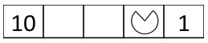
Quiz: Discounting
Given:
Actions: East, West, and Exit (only available in exit states a, e)
Transitions: deterministic
Quiz 1: For γ = 1, what is the optimal policy?
Quiz 2: For γ = 0.1, what is the optimal policy?
Quiz 3: For which γ are West and East equally good when in state d?

Slide 21

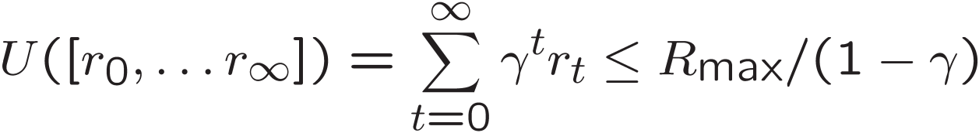
Infinite Utilities?!
Problem: What if the game lasts forever? Do we get infinite rewards?
Solutions:
Finite horizon: (similar to depth-limited search)
Terminate episodes after a fixed T steps (e.g. life)
Gives nonstationary policies (π depends on time left)
Discounting: use 0 < γ < 1
Smaller γ means smaller “horizon” – shorter term focus
Absorbing state: guarantee that for every policy, a terminal state will eventually be reached (like “overheated” for racing)

Slide 22
Recap: Defining MDPs
Markov decision processes:
Set of states S
Start state s₀
Set of actions A
Transitions P(s’|s,a) (or T(s,a,s’))
Rewards R(s,a,s’) (and discount γ)
MDP quantities so far:
Policy = Choice of action for each state
Utility = sum of (discounted) rewards
s
a
s, a
s,a,s’
s’

Slide 23
Solving MDPs

Slide 24
Optimal Quantities
The value (utility) of a state s:
V*(s) = expected utility starting in s and acting optimally
The value (utility) of a q-state (s,a):
Q*(s,a) = expected utility starting out having taken action a from state s and (thereafter) acting optimally
The optimal policy:
π*(s) = optimal action from state s
s
s is a state
a
(s, a) is a q-state
s, a
s,a,s’
(s,a,s’) is a transition
s’
Notes:
Pi is a policy. Pi* is the optimal policy from state s.

Slide 25
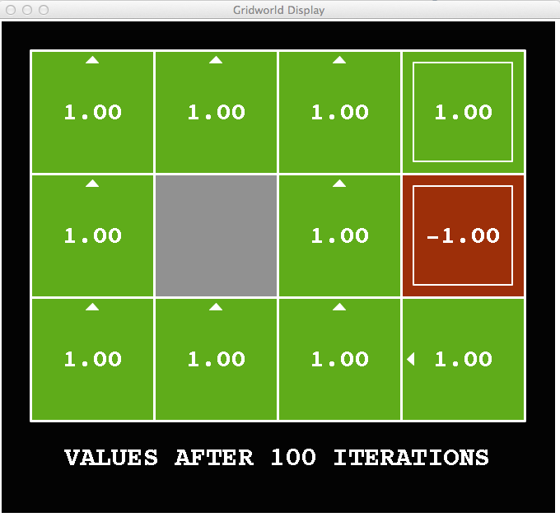
Snapshot of Demo – Gridworld V Values
Noise = 0
Discount = 1
Living reward = 0
Notes:
This demo doesn’t show anything in action, it just shows the V and Q values.

Slide 26
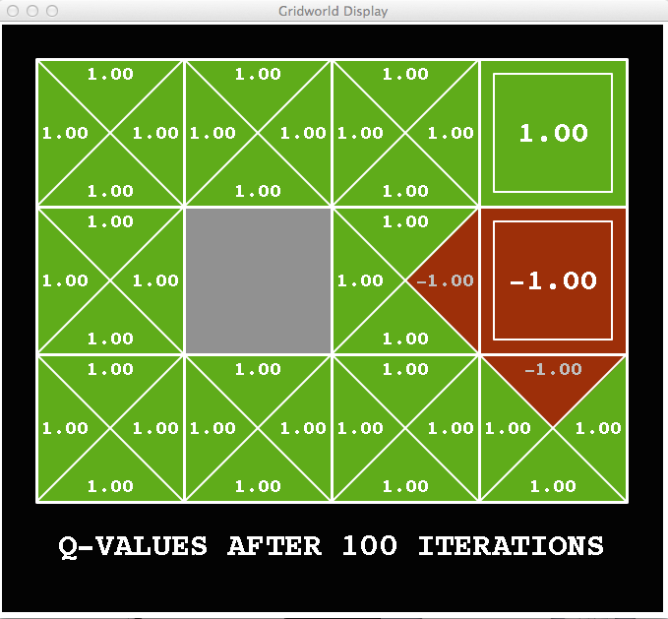
Snapshot of Demo – Gridworld Q Values
Noise = 0
Discount = 1
Living reward = 0
Notes:
This demo doesn’t show anything in action, it just shows the V and Q values.

Slide 27

Snapshot of Demo – Gridworld V Values
Noise = 0.2
Discount = 1
Living reward = 0
Notes:
This demo doesn’t show anything in action, it just shows the V and Q values.

Slide 28
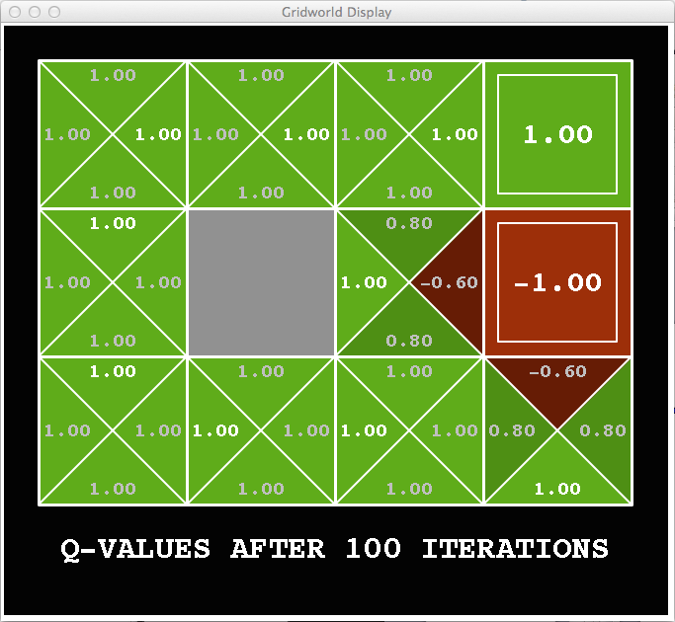
Snapshot of Demo – Gridworld Q Values
Noise = 0.2
Discount = 1
Living reward = 0
Notes:
This demo doesn’t show anything in action, it just shows the V and Q values.

Slide 29
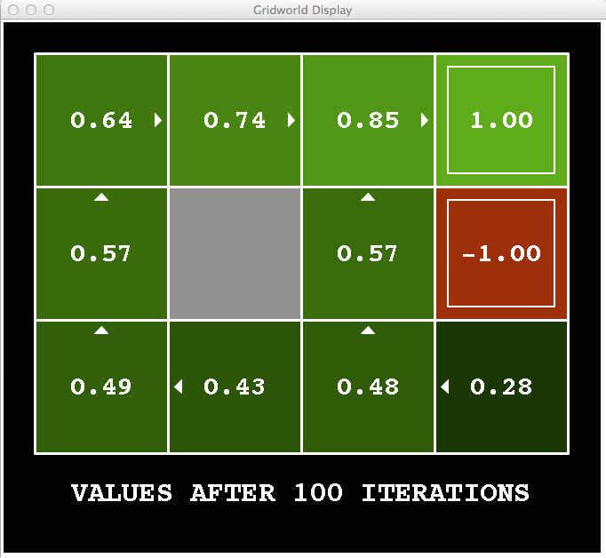
Snapshot of Demo – Gridworld V Values
Noise = 0.2
Discount = 0.9
Living reward = 0
Notes:
The arrows are the policy. In this case it is an optimal policy.
What are the numbers? What’s 0.49. This is the utility if you ran the game over and over, and sometimes you slipped, but most of the time you followed the optimal policy.
So these are the utilities. These are the values of the states.
Remember 0.57. That’s the value of the state if you’re smart going forward.

Slide 30
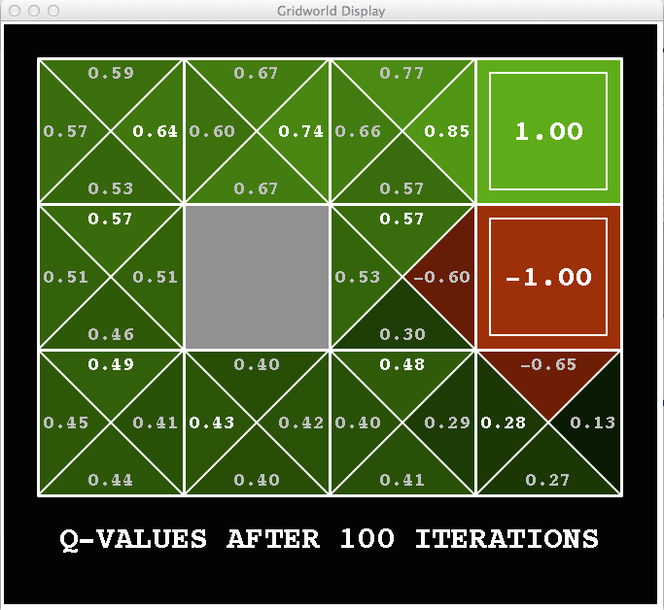
Snapshot of Demo – Gridworld Q Values
Noise = 0.2
Discount = 0.9
Living reward = 0
Notes:
What’s this? This is the Q value. If you are in that state again, and you do the right thing (go North), then the value is the optimal one. 0.57. But if you go right, then the value is negative -0.6. It’s not -1 because you may fail to go right, and then you act optimally after that.

Slide 31
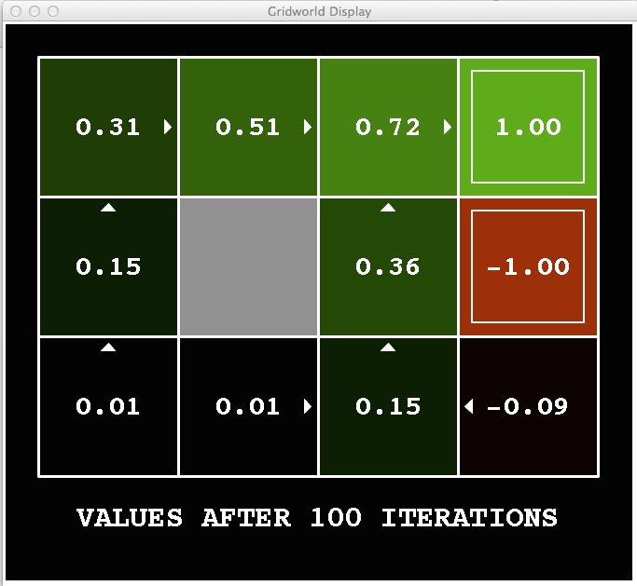
Snapshot of Demo – Gridworld V Values
Noise = 0.2
Discount = 0.9
Living reward = -0.1
Notes:
This demo doesn’t show anything in action, it just shows the V and Q values.

Slide 32
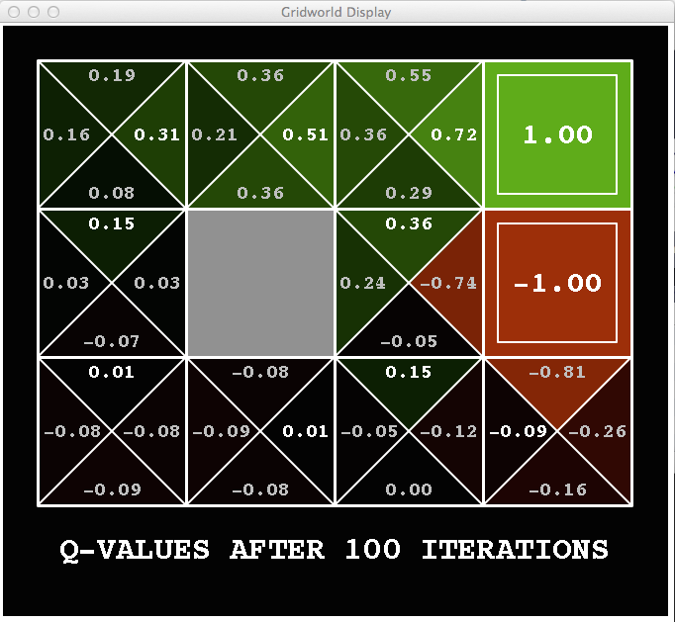
Snapshot of Demo – Gridworld Q Values
Noise = 0.2
Discount = 0.9
Living reward = -0.1
Notes:
This demo doesn’t show anything in action, it just shows the V and Q values.

Slide 33


Values of States
Fundamental operation: compute the (expectimax) value of a state
Expected utility under optimal action
Average sum of (discounted) rewards
This is just what expectimax computed!
Recursive definition of value:
s
a
s, a
s,a,s’
s’
Notes:
Max over chance nodes. That’s really just what expectimax was doing.
What do I do at a chance node Q(s,a).?
I’m going to get a reward. R(s,a,s’). Plus I’m going to get all the future rewards from this state V*(s’).
Both of course, I don’t know what’s going to happen at the chance node, so I need to sum over all states s’
We’re going to weight these by the relative probability that comes from our probability function. We write that T(s,a,s’).
We’re missing one thing. The discount of the future value. So we multiply that by Gamma.
This may look complicated, but you’re going to see this many times in the future. Don’t go into math shock. You can understand this.
We can also write this in one step. We write the expectimax recurrenece.
This is called a Bellman equation. We’re going to come back to this a lot starting in the next lecture.

Slide 34
Racing Search Tree

Slide 35


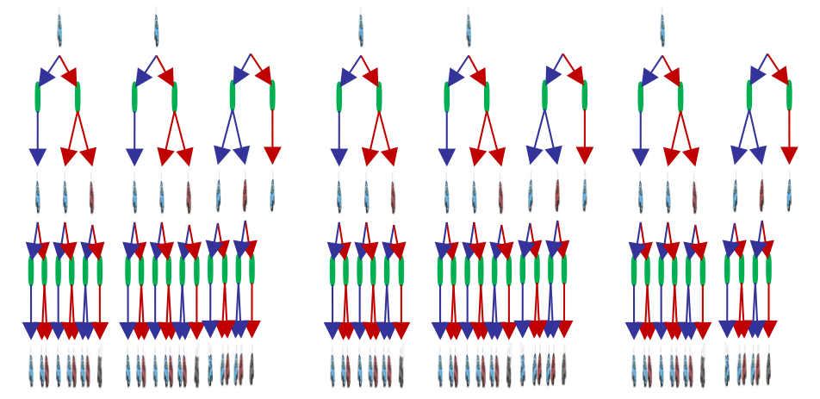

Racing Search Tree
Notes:
The tree gets very big very quickly. But I might think that expectimax is a colossal waste of time for this problem.

Slide 36
Racing Search Tree
We’re doing way too much work with expectimax!
Problem: States are repeated
Idea: Only compute needed quantities once
Problem: Tree goes on forever
Idea: Do a depth-limited computation, but with increasing depths until change is small
Note: deep parts of the tree eventually don’t matter if γ < 1
Notes:
At depth 100, then you have gamma to the 100. So it’s not going to contribute much at all.

Slide 37


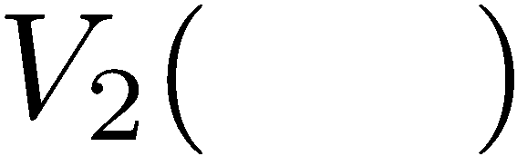


Time-Limited Values
Key idea: time-limited values
Define V_{k}(s) to be the optimal value of s if the game ends in k more time steps
Equivalently, it’s what a depth-k expectimax would give from s
Notes:
V_k is a time limited definition of V(s)

Slide 38
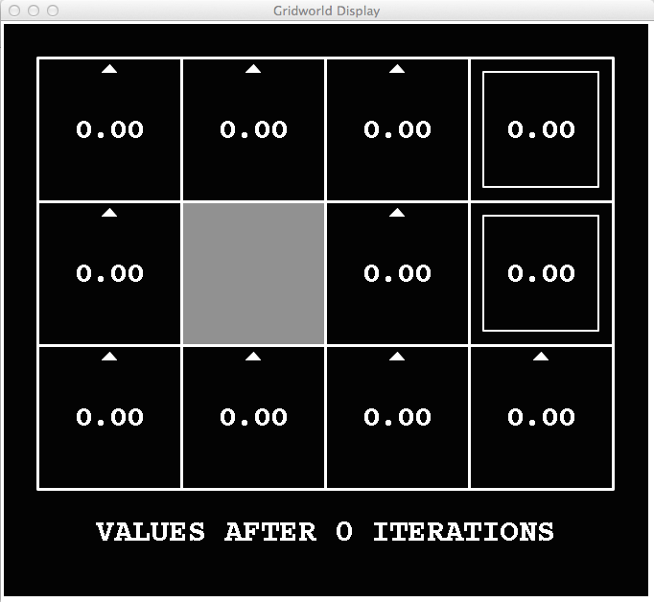
k=0
Noise = 0.2
Discount = 0.9
Living reward = 0
Notes:
Assuming zero living reward

Slide 39
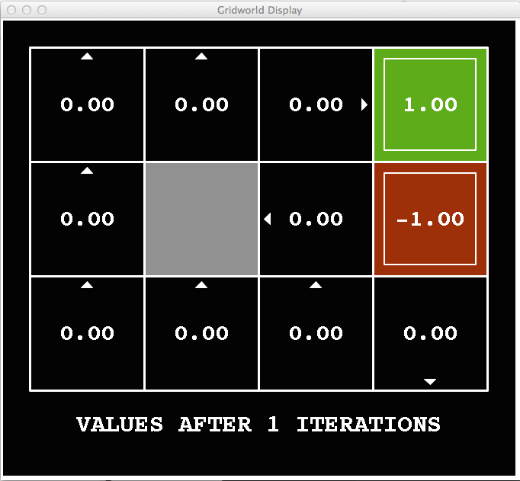
k=1
Noise = 0.2
Discount = 0.9
Living reward = 0
Notes:
Assuming zero living reward

Slide 40
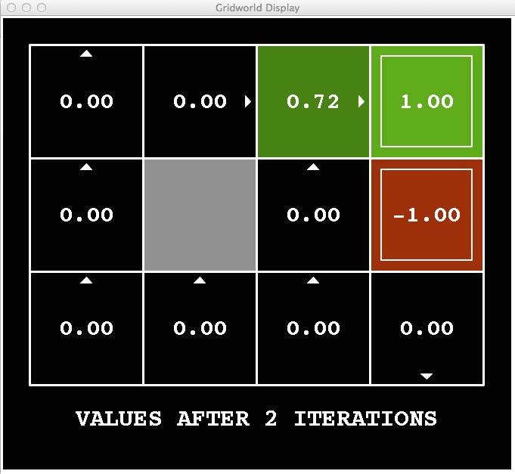
k=2
Noise = 0.2
Discount = 0.9
Living reward = 0
Notes:
Assuming zero living reward

Slide 41
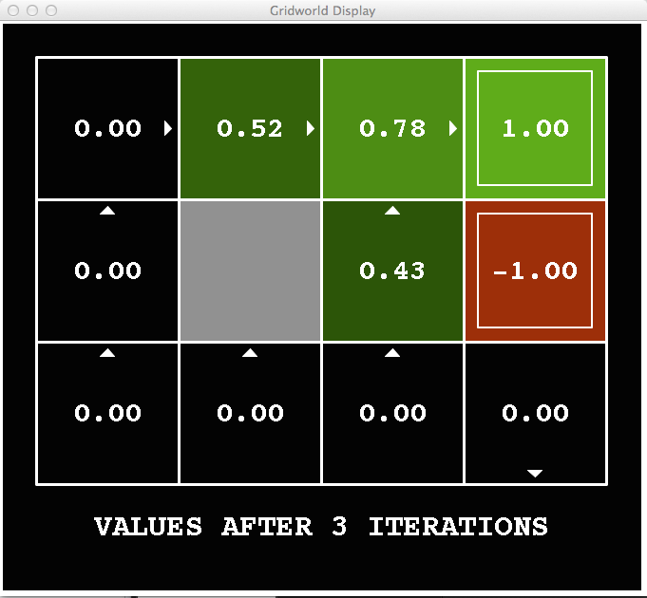
k=3
Noise = 0.2
Discount = 0.9
Living reward = 0
Notes:
Assuming zero living reward

Slide 42
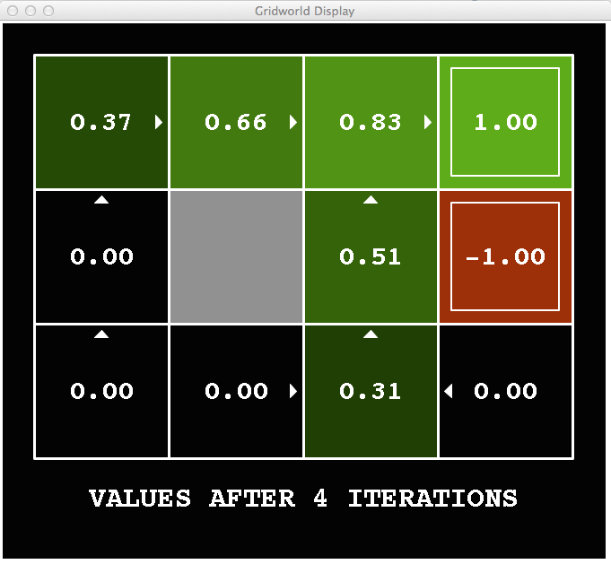
k=4
Noise = 0.2
Discount = 0.9
Living reward = 0
Notes:
Assuming zero living reward

Slide 43
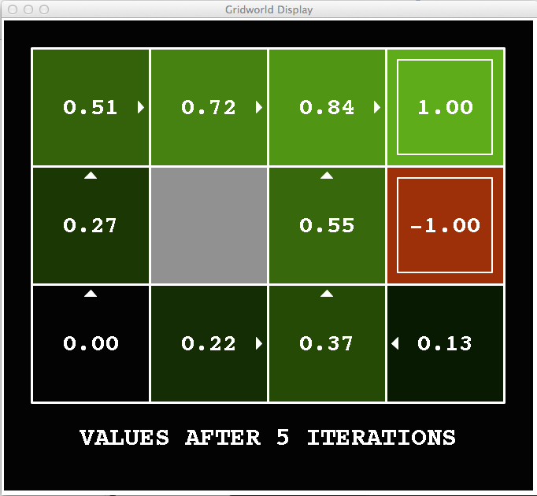
k=5
Noise = 0.2
Discount = 0.9
Living reward = 0
Notes:
Assuming zero living reward

Slide 44
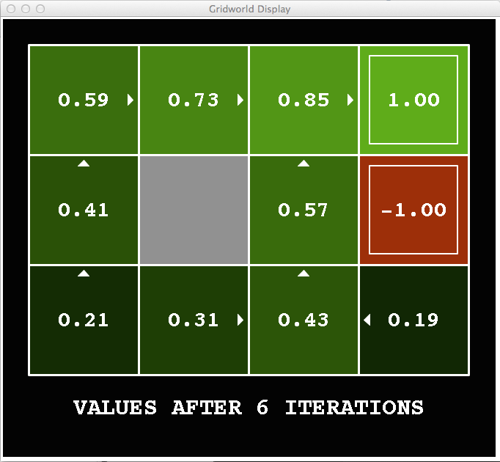
k=6
Noise = 0.2
Discount = 0.9
Living reward = 0
Notes:
What happens if I go to step 7? Will the 0.21 go up or down?

Slide 45
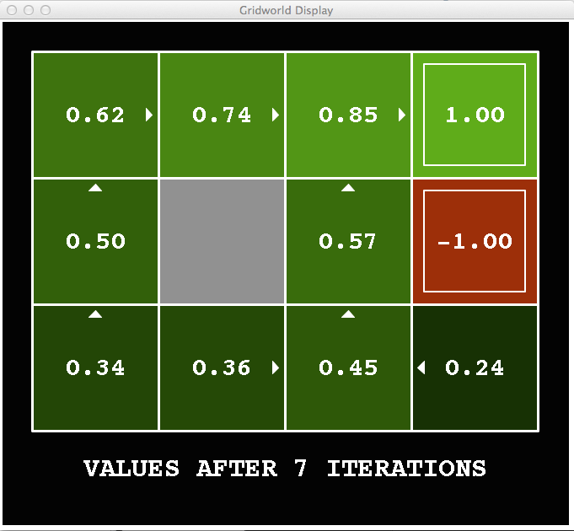
k=7
Noise = 0.2
Discount = 0.9
Living reward = 0
Notes:
Assuming zero living reward

Slide 46
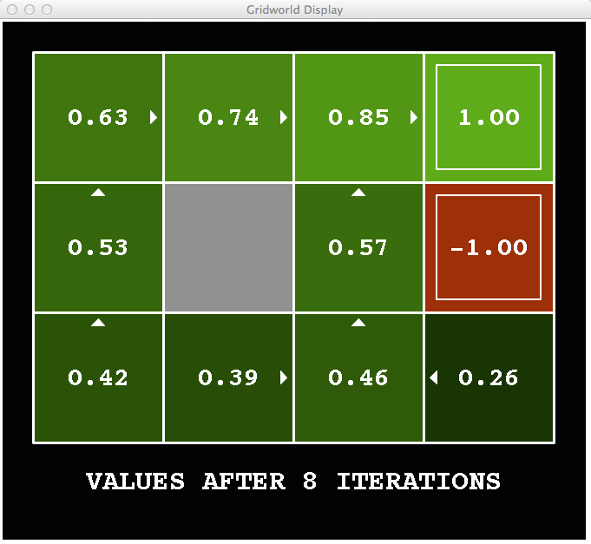
k=8
Noise = 0.2
Discount = 0.9
Living reward = 0
Notes:
Assuming zero living reward

Slide 47
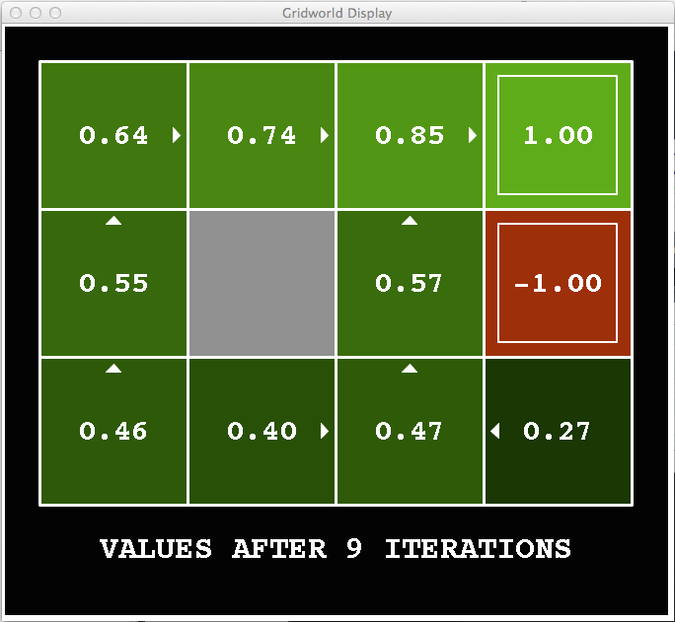
k=9
Noise = 0.2
Discount = 0.9
Living reward = 0
Notes:
Assuming zero living reward

Slide 48

k=10
Noise = 0.2
Discount = 0.9
Living reward = 0
Notes:
Assuming zero living reward

Slide 49

k=11
Noise = 0.2
Discount = 0.9
Living reward = 0
Notes:
Assuming zero living reward

Slide 50

k=12
Noise = 0.2
Discount = 0.9
Living reward = 0
Notes:
Assuming zero living reward

Slide 51

k=100
Noise = 0.2
Discount = 0.9
Living reward = 0
Notes:
Assuming zero living reward

Slide 52
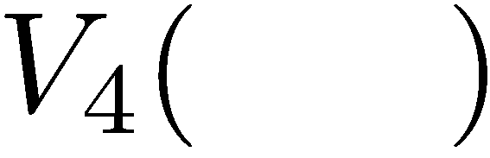

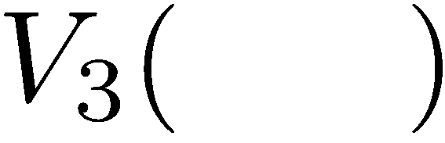
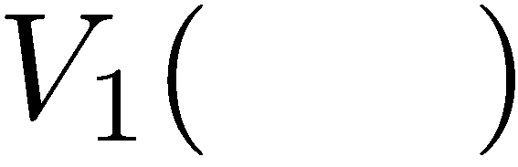
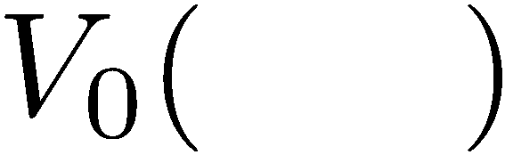
Computing Time-Limited Values
Notes:
V0, we know what it is it’s 0 for any state.
V1, is a depth 1 expectimax computation.
Each layer is a V_k for an increasing value of k.

Slide 53
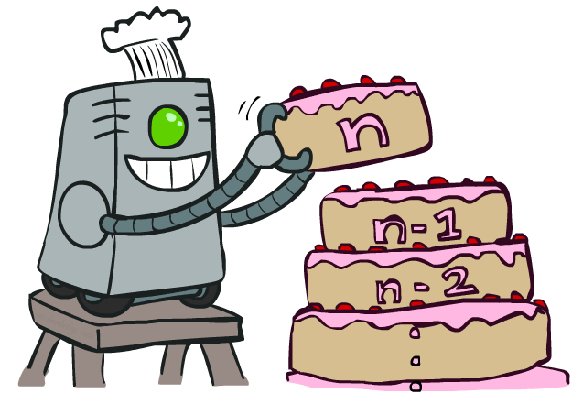
Value Iteration
Notes:
That’s an algorithm called value iteration. You can think of this as building your value from the bottom up. It will behave similarly to expectimax, but will be a lot less work, when we only have a small number of states. Let’s see how it works.

Slide 54
Value Iteration
Start with V₀(s) = 0: no time steps left means an expected reward sum of zero
Given vector of V_{k}(s) values, do one ply of expectimax from each state:
Repeat until convergence
Complexity of each iteration: O(S²A)
Theorem: will converge to unique optimal values
Basic idea: approximations get refined towards optimal values
Policy may converge long before values do
V_{k+1}(s)
a
s, a
s,a,s’
V_{k}(s’)
Notes:
We are going to store all of the V values in a vector. For V_0, everything is just 0.
The recursion is into an Expectimax tree that we have already compted. The recursion won’t actually happen because we’ve already got it.
What will this do, we can go from 0, to 1 to 2, to K. Each time we will go deeper into the tree. When should we stop? When the values start to converge.
Complexity = we do this update for each state, then we do a little expectimax. We do a for loop over A to take take a max over each action, then we do another for loop that goes over each state again.

Slide 55

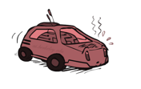
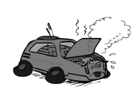
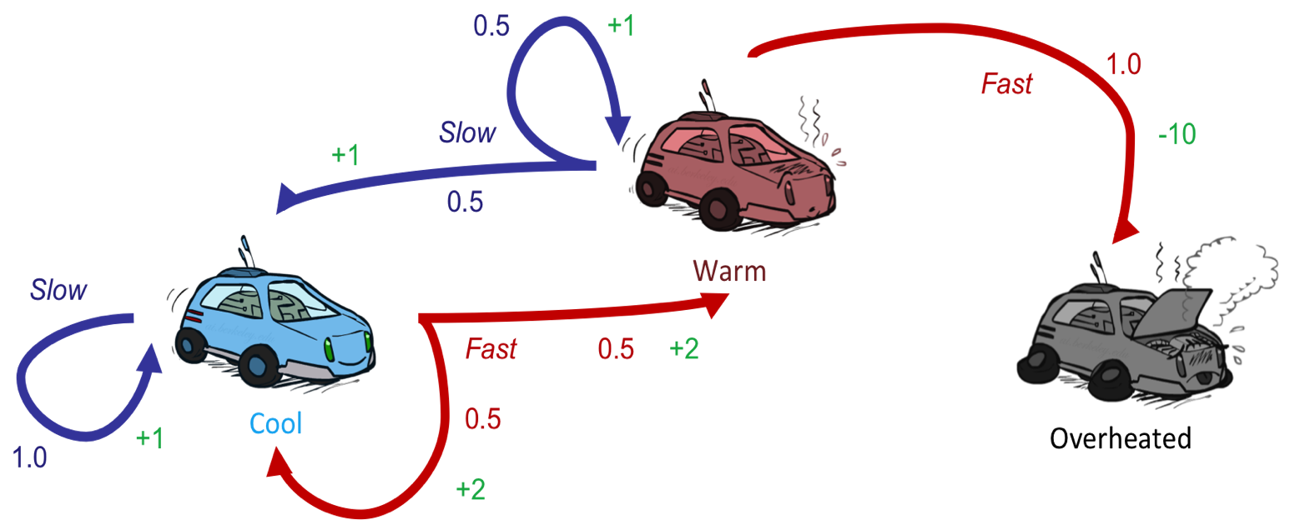
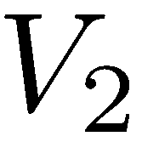
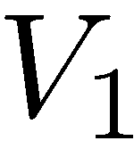
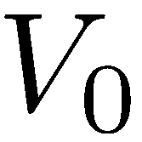
Example: Value Iteration
Assume no discount!
Notes:
V0 = 0 , 0 , 0
For V1.
On we’re going to do a little expectimax search for each value. As an equation that’s the V_k+1 ….
Let’s start with the cool state. But let’s think about it in terms of actions. What should I do. If I go slow, then I get +1, if I go fast then I get +2.
Now with the fast state, if I go slow then I get +1, if I go fast then I get -10. so max value is 1.
For V2,
Cool:
SLOW If I go slow then what do I get? I get 1, and if there’s no discount, then I’m going to land back at cool, so 2 is the Vk-1. Total is 2.
FAST If I go fast, then I’ve got a 2 instantaneously then I have a 50%/50% chance of plugging in 2 because I got sent back to cool, and plugging in 1 if I go to 1. Total = 3.5
So for cool, the max works out to 3.5
If I work that out for the warm state, then that comes out to 2.5.
As I go further up, then the numbers go up. That makes sense because I’m accumulating rewards at each step.
From this we can work out an optimal policy (when you’re cool go fast when you’re warm go slow).

Slide 56
Example: Value Iteration
3.5 2.5 0
2 1 0
Assume no discount!
0 0 0
Notes:
V0 = 0 , 0 , 0
For V1.
On we’re going to do a little expectimax search for each value. As an equation that’s the V_k+1 ….
Let’s start with the cool state. But let’s think about it in terms of actions. What should I do. If I go slow, then I get +1, if I go fast then I get +2.
Now with the fast state, if I go slow then I get +1, if I go fast then I get -10. so max value is 1.
For V2,
Cool:
SLOW If I go slow then what do I get? I get 1, and if there’s no discount, then I’m going to land back at cool, so 2 is the Vk-1. Total is 2.
FAST If I go fast, then I’ve got a 2 instantaneously then I have a 50%/50% chance of plugging in 2 because I got sent back to cool, and plugging in 1 if I go to 1. Total = 3.5
So for cool, the max works out to 3.5
If I work that out for the warm state, then that comes out to 2.5.
As I go further up, then the numbers go up. That makes sense because I’m accumulating rewards at each step.
From this we can work out an optimal policy (when you’re cool go fast when you’re warm go slow).

Slide 57
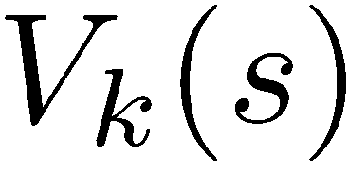
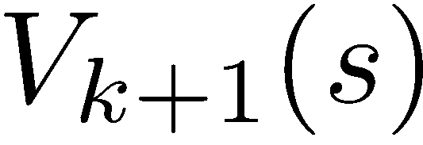
Convergence*
How do we know the V_{k} vectors are going to converge?
Case 1: If the tree has maximum depth M, then V_{M} holds the actual untruncated values
Case 2: If the discount is less than 1
Sketch: For any state V_{k} and V_{k+1} can be viewed as depth k+1 expectimax results in nearly identical search trees
The difference is that on the bottom layer, V_{k+1} has actual rewards while V_{k} has zeros
That last layer is at best all R_{MAX}
It is at worst R_{MIN}
But everything is discounted by γ^{k} that far out
So V_{k} and V_{k+1} are at most γ^{k} max|R| different
So as k increases, the values converge
Notes:
If the game is infinite, like in racing then it won’t converge.
Imagine tree V_k is actually depth V_k+1, but the last layer is all 0.
Draw height as k+1. Fill in bottom as 0.
…
How fast it converges, depends on the effective depth, or gamma. As gamma gets closer to 1, then the effective depth is deeper.

Slide 58
Next Time: Policy-Based Methods
Notes:
Since polices converged faster than the values did, then there might be a way to search over policies rather than over values.

